Slide 1
STUDY OF LIGHT POLLUTION AND IT’S CAUSES
Authored By
Gurpreet Kaur
Deepak George

Slide 2
What is Light Pollution?
Light pollution is an unwanted consequence of outdoor lighting and includes such effects as sky glow, light trespass, and glare.
Sky glow is a brightening of the sky caused by both natural and human-made factors. The key factor of sky glow that contributes to light pollution is outdoor lighting.
Light trespass is light being cast where it is not wanted or needed, such as light from a streetlight or a floodlight that illuminates a neighbor’s bedroom at night making it difficult to sleep.
Glare can be thought of as objectionable brightness. It can be disabling or discomforting. There are several kinds of glare, the worst of which is disability glare, because it causes a loss of visibility from stray light being scattered within the eye.

Slide 3
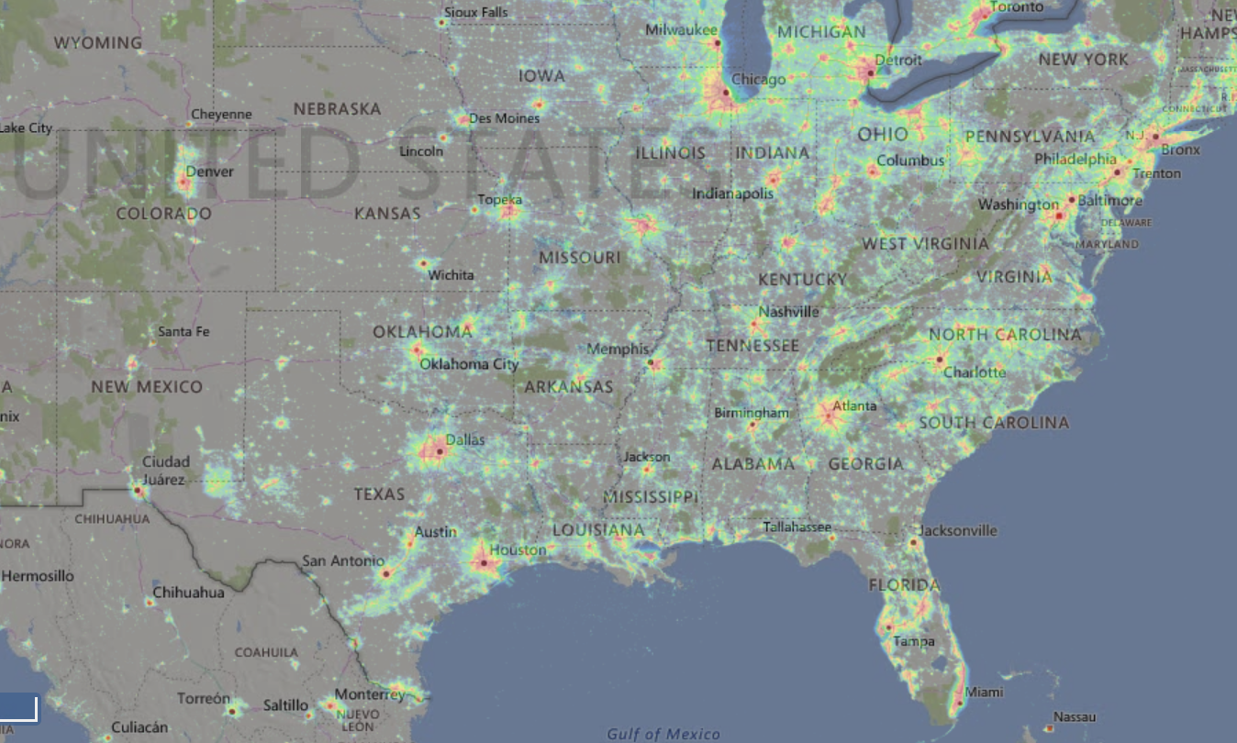
Light Pollution Map of USA

Slide 4
Negative Effects of Light Pollution on Humans
Disruption in Circadian rhythms of Humans
Reduction in Melatonin secretion thereby causing problems to regulating our daily activities
Causes desynchronization of our internal rhythms and sleep disorders
Some studies attribute the increasing menace of light has a little influence on breast cancer in women
Disability glare leads to virtual loss of vision and causes dangerous driving conditions during night time
Directly related to depression, obesity and a multitude of psychological impacts as studies claim

Slide 5
Negative Effects of Light Pollution on Ecosystem and Wildlife
1
2
3
Drastically affects the lifestyle of nocturnal Mammals and birds
Birds that migrate or hunt at night navigate by moonlight and starlight. Artificial light can cause them to wander off course and toward the dangerous nighttime landscapes of cities.
Many insects are drawn to light, but artificial lights can create a fatal attraction. Declining insect populations negatively impact all species that rely on insects for food or pollination.

Slide 6
Problem Statement
The study focusses on determining the influence that human economic, social and commercial activity has on Light Pollution
Many factors that involve our changing lifestyles, industrial revolution, around the clock manufacturing and workforce culture, nightlife and recreation, our complex transport and energy infrastructure contribute towards Light Pollution”
We intend to study this phenomenon by factoring in variables that represent economic activity, transport and energy usage.

Slide 7
Variables Considered
Variables considered for the study represent human activities such as economical, transportation and energy consumption
GDP per Capita → Represents the activities and ability of a nation to keep the economic, commercial and social engine running which have caused sweeping changes in our lifestyles, work habits and recreational and leisure activities.
Electricity Consumption → The consumption of electricity for domestic and industrial purposes for different purposes, of which lighting and illuminating is one.
Vehicle Sale → The sale of motor vehicles that represents the biggest fraction of our transportation system.
Radiance → The magnitude of light pollution is measured using this parameter that factors in the population and the area of a country.
The data for these contributing variables were collected from reliable international resources for the years 2012-2015.

Slide 8
Continued
Intended to add Forest cover area and also consider the land area occupied by industrial and commercial activities for every country in the analysis.
Could not implement it due to lack of appropriate data sources.
Countries close to the poles have high aurora activity and that could alter the radiance level readings.

Slide 9
Data Sources
Light Pollution Dataset → https://www.lightpollutionmap.info/
Population Dataset → http://databank.worldbank.org/data/reports.aspx?source=2&series=SP.POP.TOTL&country=
Electricity Consumption Dataset → http://databank.worldbank.org/data/reports.aspx?source=2&series=EG.USE.ELEC.KH.PC&country=
https://yearbook.enerdata.net/#electricity-domestic-consumption-data-by-region.html
Vehicle Sale Dataset → https://knoema.com/atlas/topics/Transportation/Motor-Vehicle-Sales/Motor-vehicle-sales
https://knoema.com/atlas/topics/Transportation/Motor-Vehicle-Sales/Commercial-vehicle-sales
GDP per Capita Dataset → https://knoema.com/atlas/topics/Economy/National-Accounts-Gross-Domestic-Product/GDP

Slide 10
Initial Assumptions
Increasing economic and commercial activities represented as GDP directly contributes towards light pollution.
Increase in GDP results in increase in Radiance levels.
Increase in Electricity consumption results in increased Radiance levels (good part of energy consumption goes into lighting needs).
Increase in Vehicle sales, produces an equivalent increase in radiance levels.
Light Pollution increases with each passing year.
Study focusses on the effect of human activity on light pollution. Therefore, the population parameter is used as a normalizing factor for all other independent variables in the model.

Slide 11
How the Study was done.
Population has a varying influence over Light Pollution. It was used only normalize the other variables.
The actual influence comes from the different economic infrastructures built by the population.
Light pollution is measured in terms of Radiance/1000 pop* and that is the dependent variable in our models. (The same normalization factor was used for all other independent variables except GDP).
Electricity usage is measured in Billion kWh/1000 pop*.
Vehicle sale is measured in terms of number of vehicles sold/1000 pop* persons.
Gross Domestic Product is factored in as GDP per capita.
*Pop -> Indicates population

Slide 12
Data Cleaning
All the individual datasets were mostly clean except a few null/blank values for a few countries.
After eliminating the missing/blank values, the next step was to ensure that names of countries were consistent across all data sets to ensure proper merging in the final dataset. E.g.
United States or United States of America
United Arab Emirates or UAE
Republic of Korea or ROK or South Korea
Removing outliers –
Initial inspection of data revealed that Canada had the highest Radiance levels which were very high in comparison to the rest of the countries.
Possible cause – Aurora activity in polar regions.
Thus, Canada was excluded from analysis.
Electricity Data was available only till 2014 and the light pollution data was available from 2013 to 2015. Thus the analysis had to be restricted to 2013, 2014 only.

Slide 13
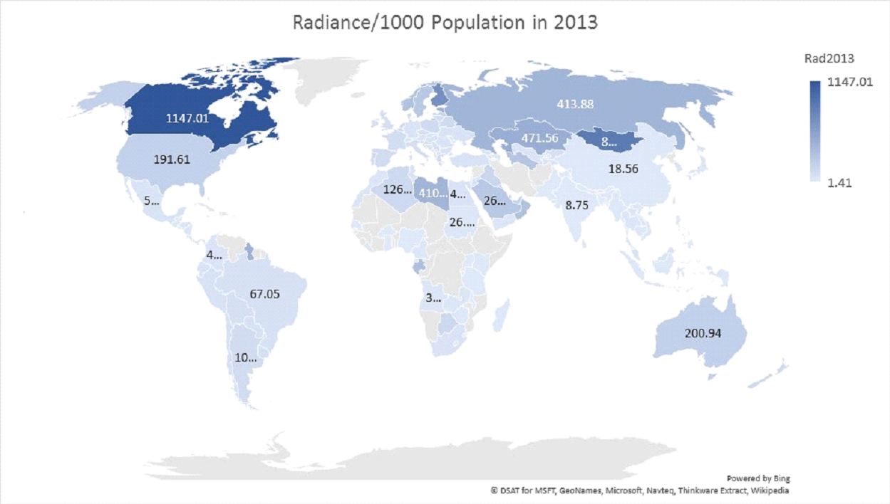

Slide 14
Merged DataSet
Country | Rad2013 | Rad2014 | Rad2015 | GDP2013 | GDP2014 | GDP2015 | Veh2013 | Veh2014 | Veh2015 | Elec2013 | Elec2014
Canada | 1147.0106 | 1223.4897 | 1840.3265 | 52266.1757 | 50185.4815 | 43248.5299 | 50.6471 | 53.1849 | 54.1103 | 0.0151 | 0.0149
Mongolia | 868.2515 | 772.4995 | 601.7379 | 4400.6145 | 4201.7377 | 3967.8294 | 0.7695 | 0.5499 | 0.3379 | 0.0018 | 0.0019
Bahamas | 268.5389 | 182.7993 | 562.7121 | 22554.4541 | 22497.4497 | 22817.2309 | 7.4105 | 6.5265 | 9.0202 | 0.0042 | 0.0042
Libya | 410.4715 | 342.1825 | 444.7313 | 10453.9704 | 6573.3867 | 4643.3058 | 7.1816 | 7.1897 | 8.6168 | 0.0020 | 0.0015
Qatar | 421.3425 | 460.6441 | 386.1807 | 94574.2551 | 94944.0856 | 73653.3944 | 40.4514 | 42.7704 | 38.6516 | 0.0145 | 0.0157
Australia | 200.9350 | 180.3991 | 348.8876 | 67652.6832 | 61995.8297 | 56310.9630 | 49.1504 | 47.4437 | 48.5850 | 0.0096 | 0.0095
Saudi Arabia | 264.4651 | 263.5547 | 330.4109 | 24646.0209 | 24406.4765 | 20481.7453 | 24.5025 | 26.8143 | 26.3186 | 0.0082 | 0.0088
United States of America | 191.6106 | 200.4753 | 168.3437 | 52749.9112 | 54539.6656 | 56115.7184 | 50.1962 | 51.8102 | 54.3548 | 0.0122 | 0.0123
China | 18.5637 | 15.5293 | 17.7722 | 7077.7706 | 7683.5020 | 8027.6838 | 16.1960 | 17.2246 | 17.9385 | 0.0036 | 0.0037
India | 8.7464 | 9.7846 | 10.1173 | 1456.2016 | 1576.8177 | 1598.2590 | 2.5333 | 2.4527 | 2.6127 | 0.0007 | 0.0008

Slide 15
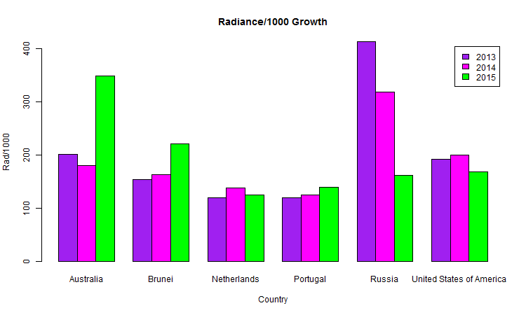
Observations
Radiance Growth is inconsistent and not continuously rising as opposed to the initial assumption.

Slide 16
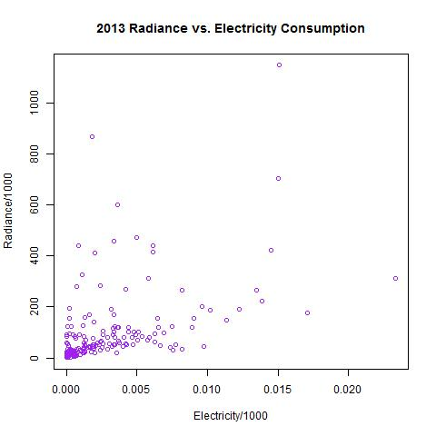
Observations - Radiance vs Electricity
Analysis Done → Linear modeling Between Electricity Consumption and Radiance
Result → Exhibits a flat distribution which explains the fact that energy generated is used for a variety of purposes commercially and at the domestic scale; and not all of it is used for lighting purposes. Electricity as a single driver variable is not significant.
Takeaways → Some Island nations that count towards low electricity consumption have shown high Radiance levels, which probably is a result of activities relating to tourism, recreational and predominantly domestic consumption (primary energy usage is to empower these areas and not for industrial activities). European countries with higher electricity consumption have a more even distribution in terms of light pollution (which probably explains low levels of usage for lighting as compared other industrial usages.

Slide 17
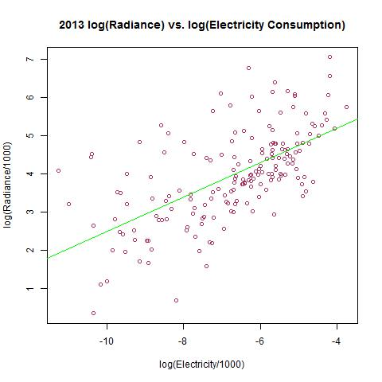
Observations – Radiance vs Electricity
Call:
lm(formula = log(Rad2013) ~ log(Elec2013), data = Pol_Elec)
Residuals:
Min 1Q Median 3Q Max
-2.6216 -0.5732 -0.1645 0.3972 2.6212
Coefficients:
Estimate Std. Error t value Pr(>|t|)
(Intercept) 6.9822 0.2970 23.51 <2e-16 ***
log(Elec2013) 0.4492 0.0428 10.49 <2e-16 ***
---
Signif. codes:
0 ‘***’ 0.001 ‘**’ 0.01 ‘*’ 0.05 ‘.’ 0.1 ‘ ’ 1
Residual standard error: 0.9414 on 176 degrees of freedom
Multiple R-squared: 0.3848, Adjusted R-squared: 0.3814
F-statistic: 110.1 on 1 and 176 DF, p-value: < 2.2e-16

Slide 18
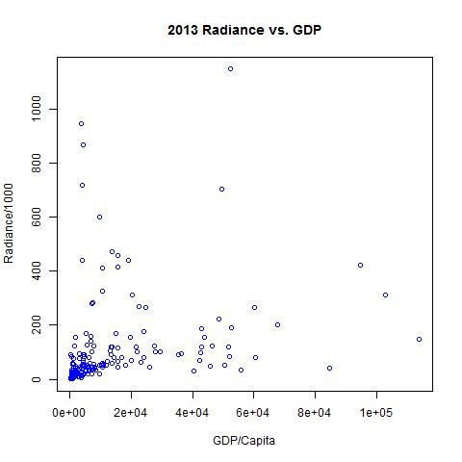
Observations – Radiance vs GDP
Analysis Done → Compared GDP against Radiance
Result → Relationship between GDP and Radiance exhibits a certain degree of randomness with the general distribution mimicking a downward sloping curve with most of the observations clustered around the low GDP and low Radiance zone.
Takeaways → Goes against the initial assumption that GDP (that represents economic activity) directly contributes towards Light Pollution. Even nations with high GDP value have shown low radiance levels. The larger countries (in terms of Area) are usually the highest contributors.

Slide 19
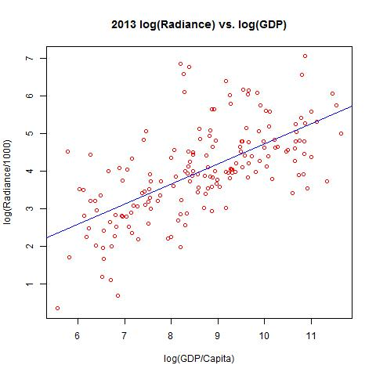
Observations – Radiance vs GDP
Analysis Done → Linear modeling Using Log Transformation of GDP and Radiance
Result → Exhibits an almost linear distribution with a Standard Error of 0.05
Takeaways → The relationship is not linear and follows a much more complex pattern.
lm(formula = log(Rad2013) ~ log(GDP2013))
Coefficients:
Estimate Std. Error t value Pr(>|t|)
(Intercept) -0.59659 0.43054 -1.386 0.168
log(GDP2013) 0.53081 0.04917 10.795 <2e-16 ***
Residual standard error: 0.945 on 173 degrees of freedom
Multiple R-squared: 0.4025, Adjusted R-squared: 0.399
F-statistic: 116.5 on 1 and 173 DF, p-value: < 2.2e-16

Slide 20
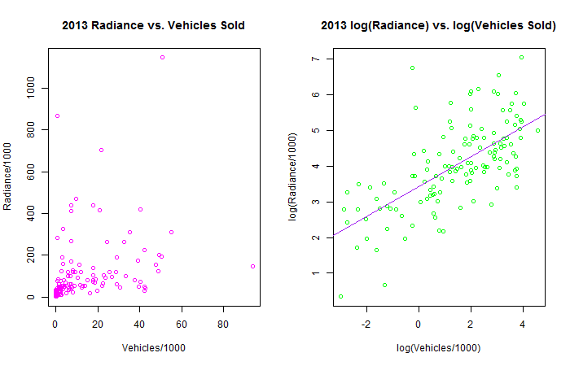
Observations – Radiance vs Vehicle Sales
Analysis Done → Linear modeling Using Log Transformation of Vehicle Sales and Radiance
Result → The model was able to explain 42% of variance.
Takeaways → Just like GDP, the relationship between Vehicle Sales and Radiance is not as direct as we initially thought of.
lm(formula = log(Rad2013) ~ log(Veh2013))
Coefficients:
Estimate Std. Error t value Pr(>|t|)
(Intercept) 3.43154 0.09931 34.555 <2e-16 ***
log(Veh2013) 0.42003 0.04241 9.905 <2e-16 ***
Residual standard error: 0.8984 on 130 degrees of freedom
Multiple R-squared: 0.4301, Adjusted R-squared: 0.4257
F-statistic: 98.1 on 1 and 130 DF, p-value: < 2.2e-16

Slide 21
Best Model Achieved
The best models created explained a good 50-53 % of the variation in the Radiance levels recorded for the different countries.
Introducing an interaction of GDP and Electricity reduced the Adjusted-R² However, its high t-value and low p-value indicated a certain level of inter-dependence and interaction between GDP and electricity (energy usage in general).
There is some degree of interaction between GDP and Vehicle Sales variables as well. The introduction of an interaction term between GDP and Vehicle Sales explained more variation in Radiance levels.
In one of the models with lowest p-values, highest F-statistic and Adjusted-R², the variables considered were the log transformations of Vehicle sale and GDP and the interaction between them and the non-transformed normalized electricity consumption data.

Slide 22
Best Model Achieved
Call:
lm(formula = log(Rad2013) ~ Veh2013 + log(GDP2013) + Elec2013,
data = finaldf)
Residuals:
Min 1Q Median 3Q Max
-2.10654 -0.39262 -0.04822 0.29572 2.98672
Coefficients:
Estimate Std. Error t value Pr(>|t|)
(Intercept) -1.231382 0.753651 -1.634 0.1048
Veh2013 -0.018009 0.007926 -2.272 0.0248 *
log(GDP2013) 0.582691 0.094659 6.156 9.53e-09 ***
Elec2013 75.541491 32.374168 2.333 0.0212 *
---
Signif. codes: 0 ‘***’ 0.001 ‘**’ 0.01 ‘*’ 0.05 ‘.’ 0.1 ‘ ’ 1
Residual standard error: 0.8407 on 124 degrees of freedom
Multiple R-squared: 0.5164, Adjusted R-squared: 0.5047
F-statistic: 44.13 on 3 and 124 DF, p-value: < 2.2e-16

Slide 23
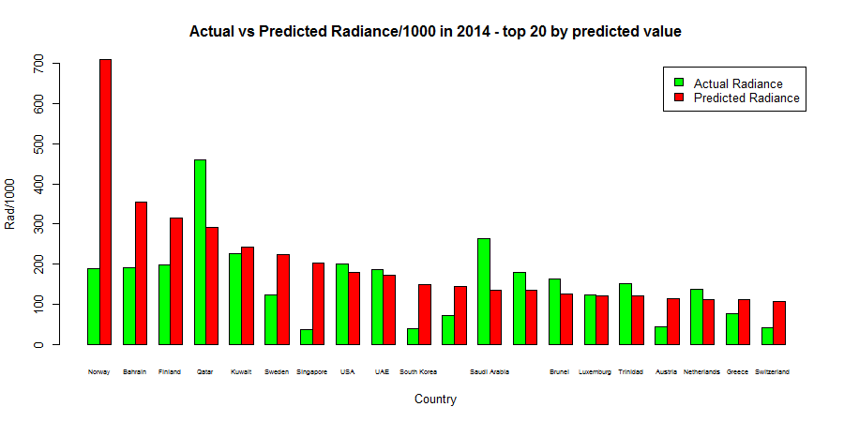
Prediction Results

Slide 24
Radiance Direction Analysis
We tried to use Logistic Regression and Naïve Bayes Regression to predict the direction of Radiance (increase/decrease) using the percentage change of GDP and Vehicle from the years 2014 to 2015.
Electricity couldn’t be included because we didn’t have the data.
Accuracy = 28% and 31% respectively.
GLM Results
Reference
Prediction 0 1
0 25 92
1 0 11
Accuracy : 0.28125
Naïve Bayes Results
Reference
Prediction 0 1
0 15 10
1 78 25
Accuracy : 0.3125

Slide 25
Future Scope
Most of the research papers that we studied, used Fractional Logit Regression to perform any regression analysis on the Light Pollution and Economic Factors affecting Light Pollution.
We plan to understand FRM and improve our models to produce better results.
We could only consider very few factors in our analysis. Due to lack of historical data, our analysis was limited to only 2013-2015 primarily.
If we are able to get more data, it might help to explain more variance and improve our models.

Slide 26
Source Code
https://github.com/Rhomi/geordee/tree/master/Study%20On%20Light%20Pollution

